Slide 1

CASE STUDY SOLUTION PRESENTATION Presented by Blue Team Sheridan Dela Cruz | Garrett Woods | Megan Mosier | Garvin Stewart
Outdoor Adventure

Slide 2
Meet Team Blue
Sheridan Dela Cruz
Garrett Woods
Megan Mosier
Garvin Stewart

Slide 3

About Outdoor Adventure

Slide 4
Case Study Overview
Outdoor Adventure is a small adventure travel company that offers guided trips to international destinations, rents and sells equipment to customers, while also managing its own equipment inventory. Outdoor Adventure needed a relational database to track employees and their roles, trip schedules and bookings, supplier purchases, customer accounts, equipment transactions, and billing. Our team designed and built an Outdoor Adventure database in MySQL, populated it with sample data, and generated business reports to support key decisions like equipment revenue analysis, regional booking trends, and inventory management.

Slide 5
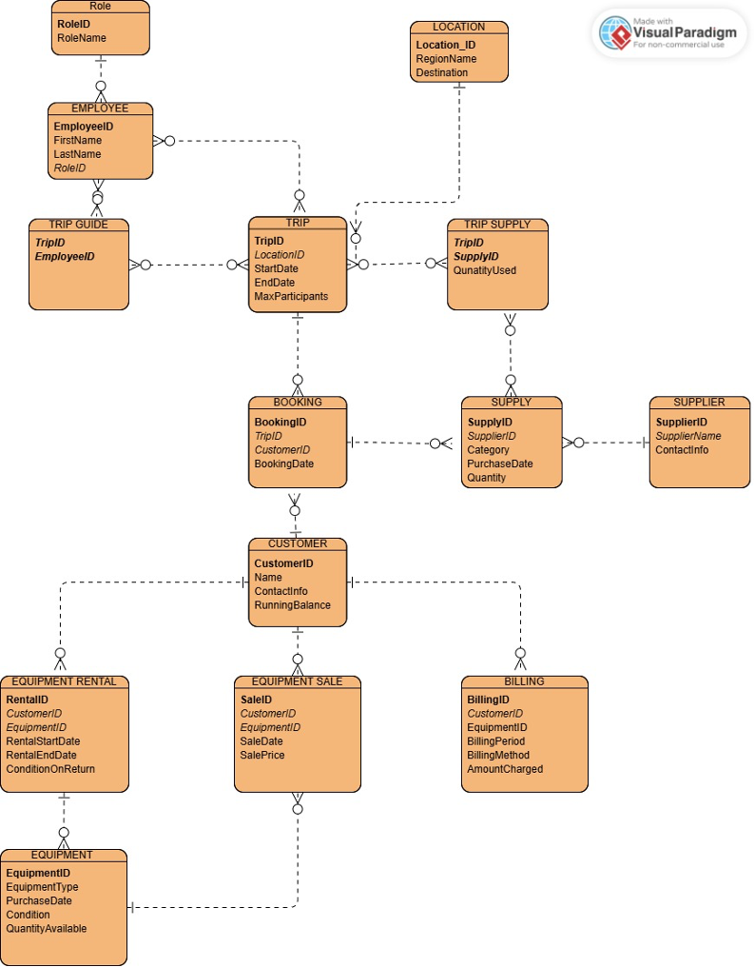
Finalized ERD
14 FULLY NORMALIZED TABLES (3NF)
BRIDGE TABLES USED FOR MANY-TO-MANY RELATIONSHIPS
STRUCTURE SUPPORTS CLEAN REPORTING AND SCALABLE GROWTH

Slide 6
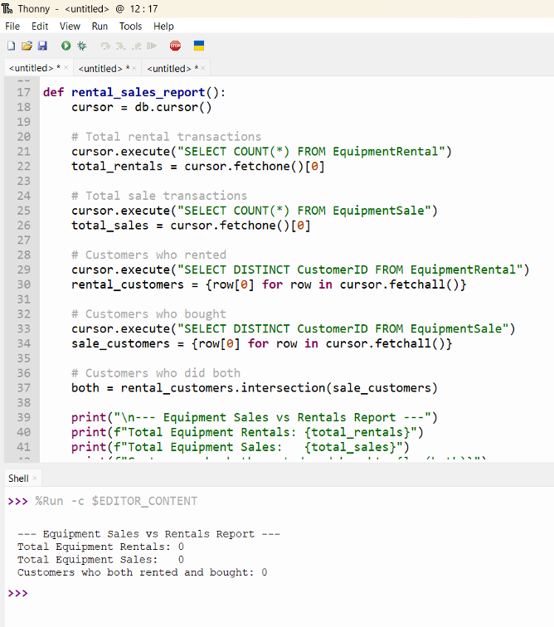
Report 1: Equipment Sales vs. Rentals
Counts total rental transactions, total sales transactions, and identifies how may customers engaged with both.
Helps management understand whether customers prefer renting vs. buying
Informs decisions about how much equipment to stock for retail sale compared to keeping rentals in fleet.

Slide 7
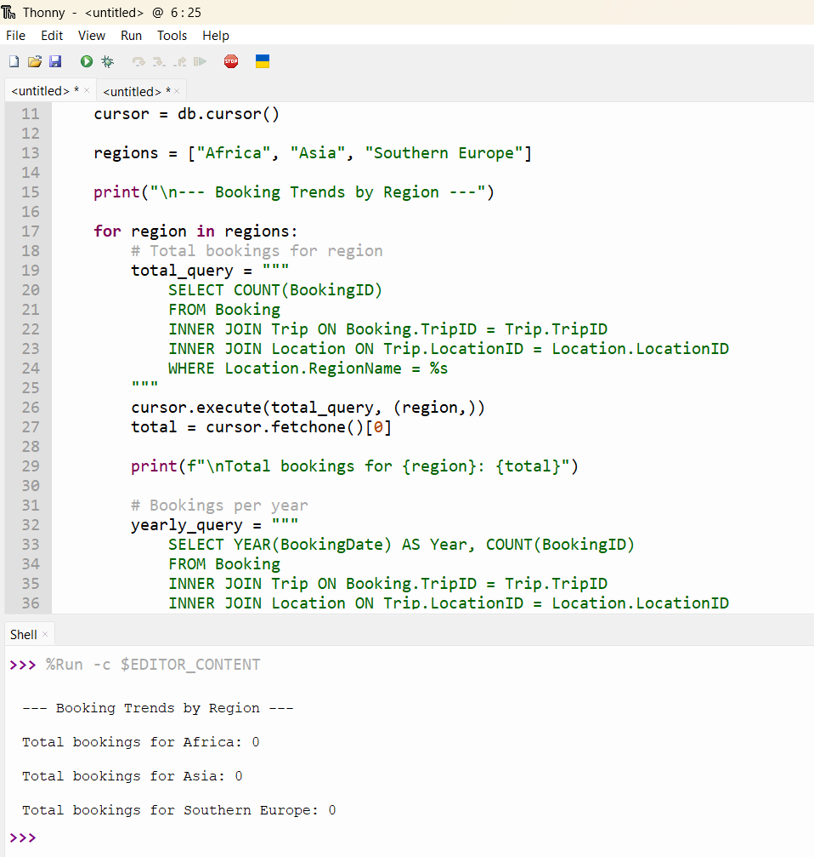
Report 2: Booking Trends by Region
Counts total bookings per region (Africa, Asia, Southern Europe) broken down by year.
Helps marketing and operations teams see which destinations are most popular and determines volume trends year over year.
Informs decisions about where to add or remove trips

Slide 8
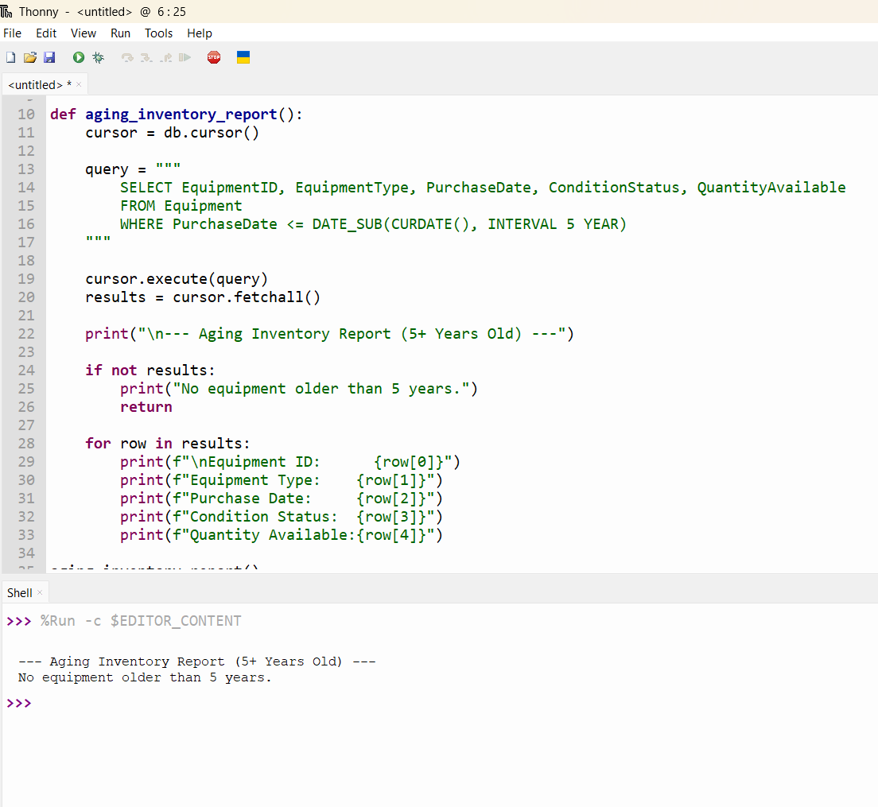
Report 3: Aging Inventory Report
This report pulls all equipment purchased 5 or more years ago showing equipment type, purchase date, condition, and quantity still available.
Helps the inventory team prioritize which items need inspection, repair, or replacement prior to becoming safety issues on upcoming guided trips.
Data Sample (for example only)
2
Items flagged
for review
Fair
Climbing Harness
condition
27
Total units
affected

Slide 9
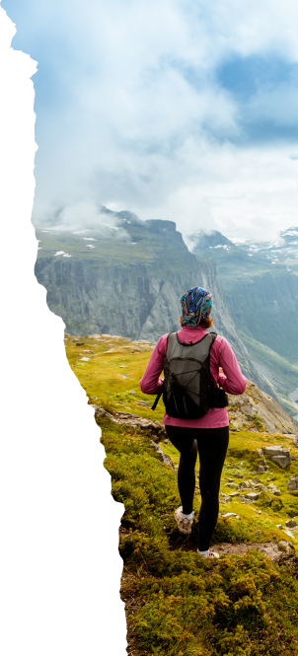
Design Assumptions
Equipment is shared between rentals and sales, one EquipmentID can appear in both tables.
Trip Guide is a bridge table. We assumed one trip can have multiple guides and one guide can lead multiple trips.
Billing is tracked separately from booking

Slide 10
Thank you
Blue team
Csd-310 milestone #4
Sheridan Dela Cruz | Garrett Wood| Megan Mosier| Garvin Stewart

